Slide 1
AIRDROP DELIVERY READY TO REACH, IN FEW MINUTES
Assignment taken
Propose marketing plan, digital marketing, brand journey of airdrop delivery drones – a marketing overview
Case understanding
Airdrop delivery is a courier company, we are providing the delivery services via drones and planned to venture into ‘hyper local delivery space’. A major challenge in this business case from marketing point of view is brand establishment and innovative measures which would set them apart as a market leader. The company also looks forward to leading in process and product and hence must focus on research and development. This will act as a competitive barrier and make airway delivery the standards setter and as the drone attributes and supply chain improves the business model will become more sustainable. The target of airdrop delivery service is to deliver the parcel of 5 km away is in just 15 minutes.

Slide 2
BCS SOLUTION SUMMARY
In the market view airdrop delivery aims to find the marketplace of big opportunities in case of deliveries like food delivery ,local deliveries as well as pharma medicine deliveries ,after finding the market place we are comparing to other delivery companies such as competitors their plans ,price ,product and services . ‘Hyper Local Delivery marketplace’ model is in other words ‘on-demand’ near me delivery model so, we will try to reach as early as possible and we will provide their boxes filled of happiness .we are focusing on DIGITAL MARKETING, ADVERTISING and as well as INDIRECT DIGITAL MARKETING .safe deliveries and fast deliveries are the main mission of our AIRDROP DELIVERY DRONE services.
SOLUTION
MARKETPLACE –
Markets where demand for product deliveries is high
Markets which demands quick deliveries (for deliveries up to 25 kg’s)
Target market-There is a big market for deliveries of fast food, groceries, daily use household items, books, electronic equipment’s etc., consumers of these products and items are the main target market for our delivery service
Competitor –
There are so many delivery services present in the market like shopX, reliance industry delivering their respective products etc. and also food delivery services like Swiggy, Zomato which are at the top of market share. So the question arises WHY customers will choose us , the simple answer is safe and fastest deliveries via the our drones ,that’s why we said the biggest new business opportunity . we will outshine the competition with this different approach of delivering goods

Slide 3
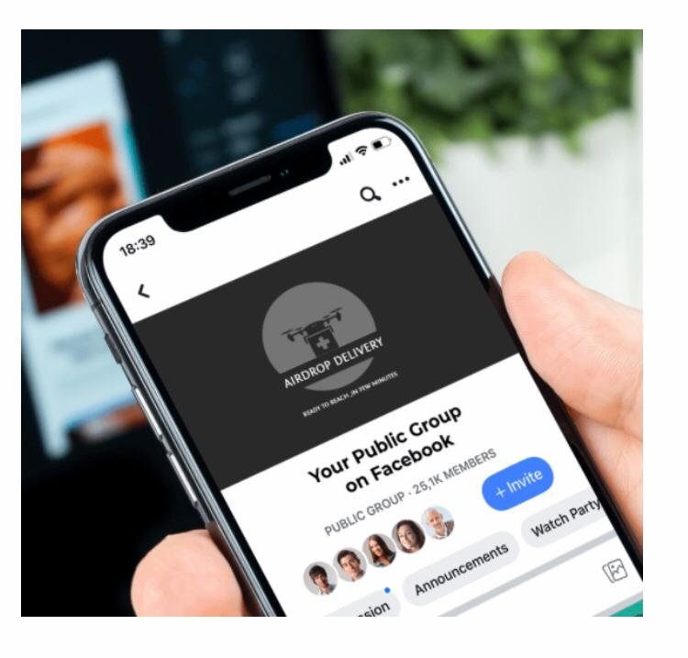
DIGITAL MARKETING –
We are focusing on where we can capture the larger chunk of market share and as per market trends the world is being currently presented digitally on social media ,websites and internet .we are targeting the same our we are making our best and simple to use application called as AIRDROP APP .

Slide 4
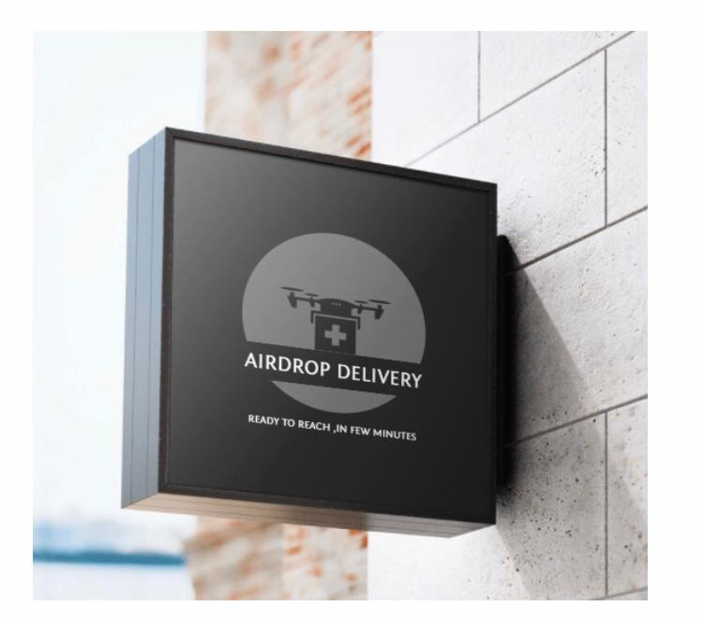
ADVERTISING – Add campaign on various social media platforms like Instagram , youtube , google adds etc. Advertisements on d2h channels about Airdrop deliveries. We will look the local influencer for the advertising and for posting on social media accounts . We are mainly focusing on physical advertising as well as digital . we are putting banners ,boards and pamphlet and visiting cards also we will show case these adds near local hotels ,medicals and most gathering places

Slide 5
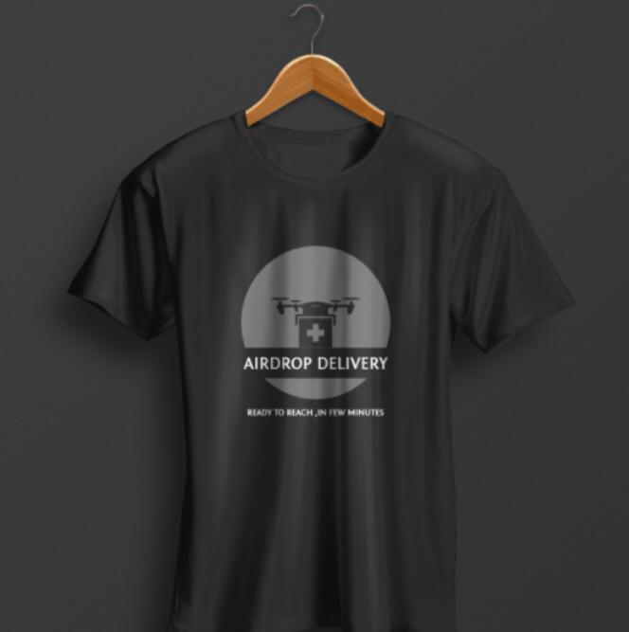
INDIRECT DIGITAL MARKETING – We are inventing new strategy for all the customers ,because all the trendy peoples loves to be trending on these days ,we providing GIVE AWAY OF AIRDROP DELIVERY T SHIRTS for one of the lucky customer through out the day.

Slide 6
Conclusion –
As drone technology is advancing rapidly and drones are becoming readily available and at low expense we have a big opportunity to be a market leader in short distance delivery service market because we know drones will provide quickest delivery method and as of now there are no players in same market for delivering goods. As companies like amazon continue to build their warehouses on many locations growth for aerial delivery services is guaranteed.
However before launching the services on large scale management team should conduct practice runs to ensure deliveries are fool proof and pay attention to customer feedback this will ensure the successful future of Airdrop delivery as a company.

Slide 7
Thank you

